Slide 1
Open Source Platform and Network Administration
Lesson 2

Slide 3
Learning Objective
Identify threats to the Linux operating system and other open source applications.

Slide 4
Key Concepts
Open source software security considerations
Impact of laws and regulations on a security policy
Threats to the seven domains of an information technology (IT) infrastructure
Standard methodologies for testing vulnerabilities on Linux and open source applications
Linux in the emerging virtual machine (VM) market

Slide 5
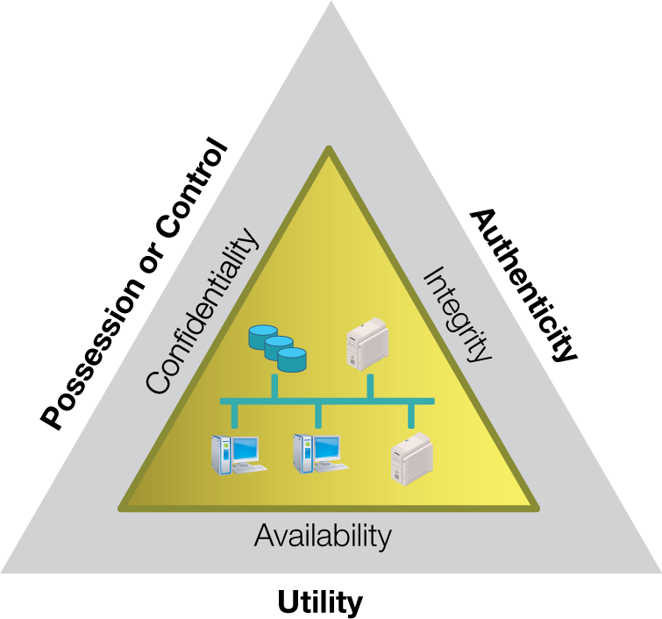
C-I-A Triad the Parkerian Hexad

Slide 6
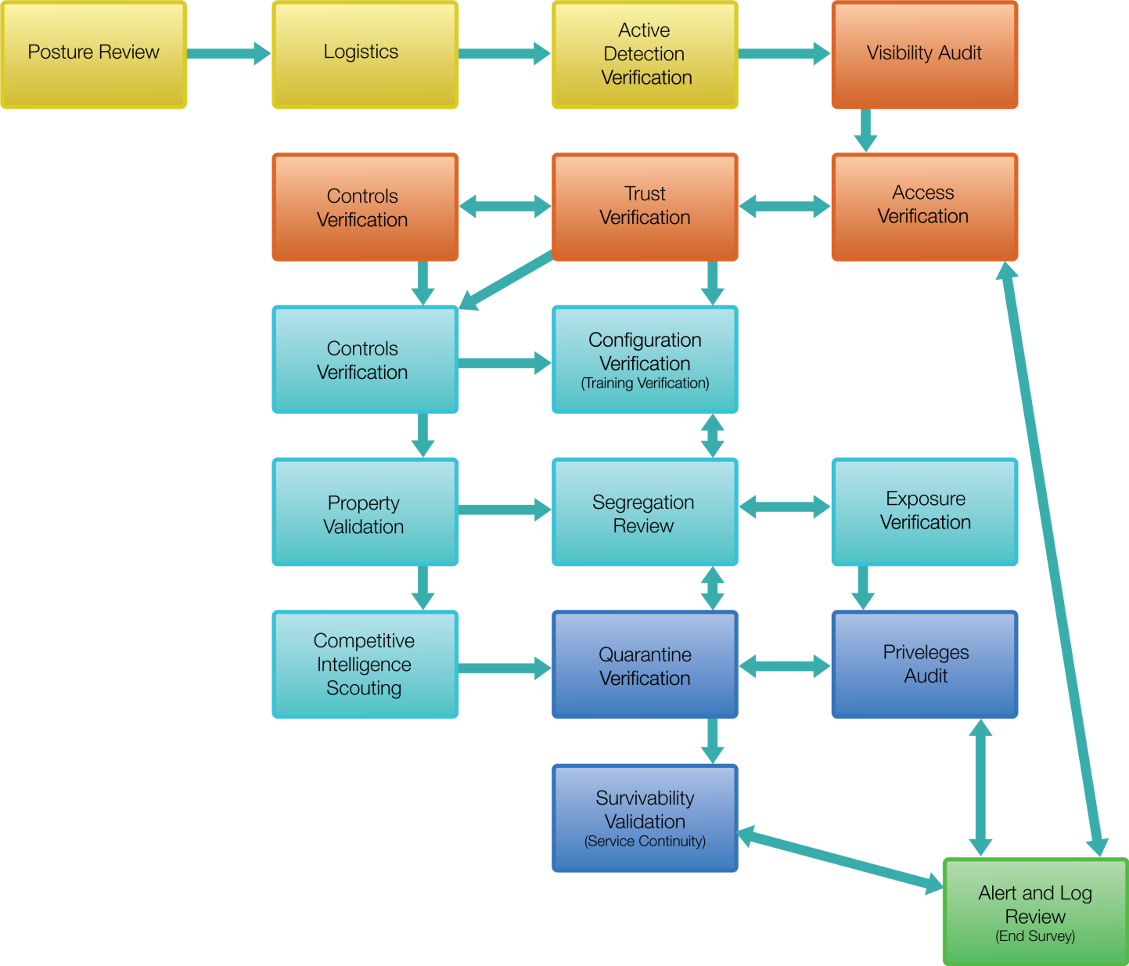
OSSTMM Test Methodologies
Notes:
From OSSTMM 3.0 Lite, 2008.

Slide 7
Defining the Security Framework
Frameworks to Choose From
Key Questions to Consider
National Institute of Standards and Technology (NIST)
Certified Information Systems Security Professional (CISSP) 10 Domains
International Organization for Standardization (ISO) 17799 and ISO 27001
Open Source Security Testing Methodology Manual (OSSTMM)
What are the critical assets and threat agents?
Who would a system compromise impact?
Where are the critical assets located?
When have past security breaches in the industry occurred?
How does legislation and regulations mandate policy?
Framework
Selection
Notes:
Framework selection

Slide 8
Responsibilities of a Linux System Administrator
System availability and performance
User access and denial
Maintenance of the integrity of operating system, application, storage files, resources, and data transmission

